Slide 1
Face Recognition Based Game Management System
Ayush(1602111015)
Bhavyansh(1602111016)

Slide 2
Introduction:-
The information age is quickly revolutionizing the way transactions are completed. Everyday actions are increasingly being handled electronically, instead of with pencil and paper or face to face. This growth in electronic transactions has resulted in a greater demand for fast and accurate user identification and authentication. Access codes for buildings, banks accounts and computer systems often use PIN's for identification and security clearences .
Using the proper PIN gains access, but the user of the PIN is not verified. When credit and ATM cards are lost or stolen, an unauthorized user can often come up with the correct personal codes. Despite warning, many people continue to choose easily guessed PIN‟s and passwords: birthdays, phone numbers and social security numbers. Recent cases of identity theft have highten the need for methods to prove that someone is truly who he/she claims to be.
Face recognition technology may solve this problem since a face is undeniably connected to its owner expect in the case of identical twins. Its nontransferable. The system can then compare scans to records stored in a central or local database or even on a smart card.

Slide 3
Why we choose face recognition over other biometric?
A biometric is a unique, measurable characteristic of a human being that can be used to automatically recognize an individual or verify an individual‟ s identity. Biometrics can measure both physiological and behavioral characteristics. Physiological biometrics (based on measurements and data derived from direct measurement of a part of the human body) include:
Finger-scan
Facial Recognition
Iris-scan
Retina-scan
Hand-scan

Slide 4
Python:
Python is a general-purpose interpreted, interactive, object-oriented, and high-level programming language. It was created by Guido van Rossum during 1985- 1990. Like Perl, Python source code is also available under the GNU General Public License (GPL).
Python is designed to be highly readable. It uses English keywords frequently where as other languages use punctuation, and it has fewer syntactical constructions than other languages.

Slide 5
Why we use Python
Python developers around the world provide comprehensive support and assistance via forums and tutorials making the job of the coder easier than any other popular languages.
Python is platform Independent and is hence one of the most flexible and popular choices for use across different platforms and technologies with the least tweaks in basic coding.
Python is the most flexible of all others with options to choose between OOPs approach and scripting. You can also use IDE itself to check for most codes and is a boon for developers struggling with different algorithms.

Slide 6
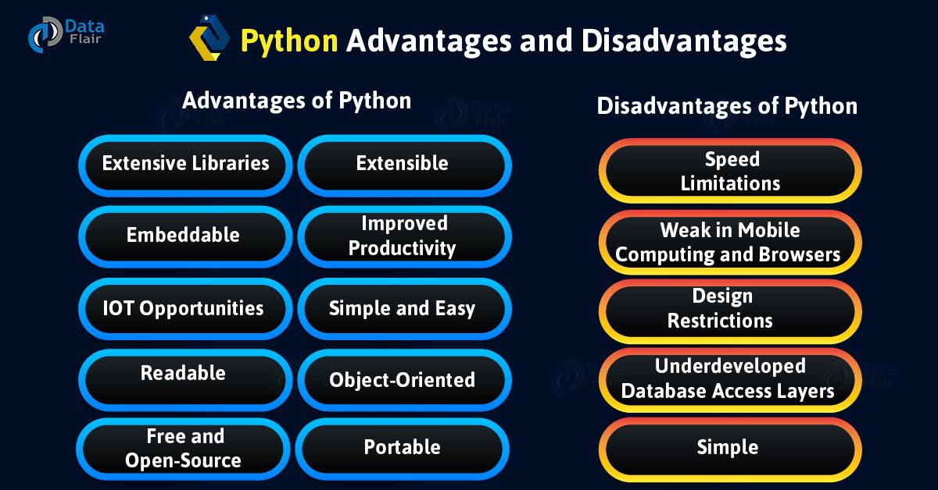
Advantage & Disadvantage of Python

Slide 7
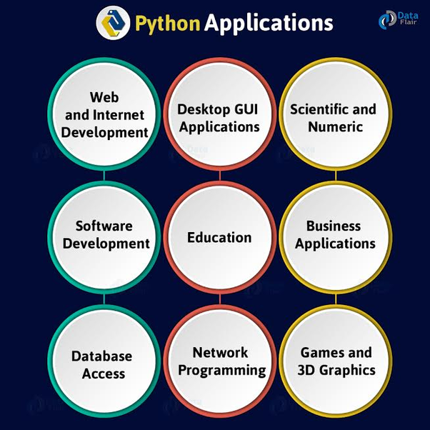
Applications of Python

Slide 8
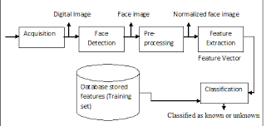
Data Flow in FR

Slide 9
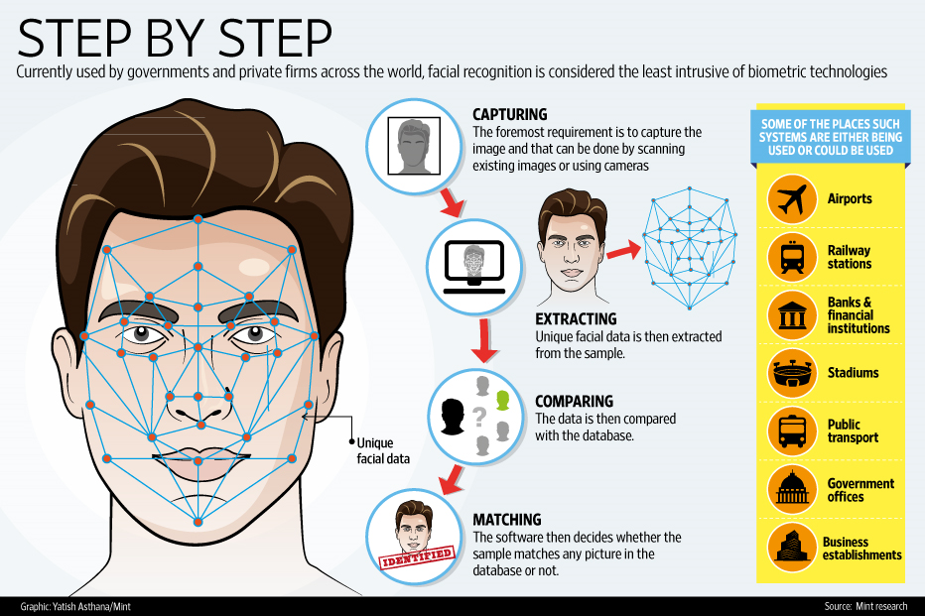
How FR verified the Data

Slide 10
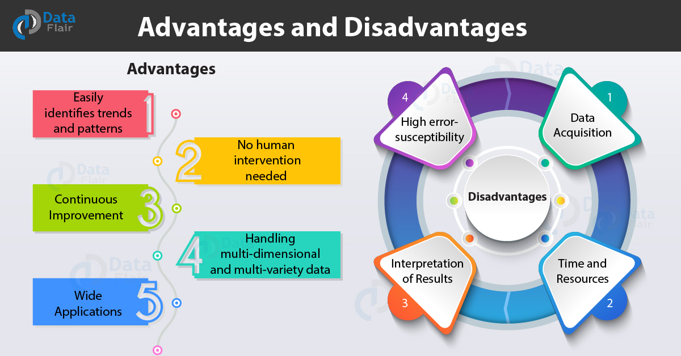
Some Advantages & Disadvantages

Slide 11
Pygame
Pygame is a cross-platform set of Python modules designed for writing video games. It includes computer graphics and sound libraries designed to be used with the Python programming language.
Pygame was originally written by Pete Shinners to replace PySDL after its development stalled.It has been a community project since 2000 and is released under the open source free software GNU Lesser General Public License.

Slide 13
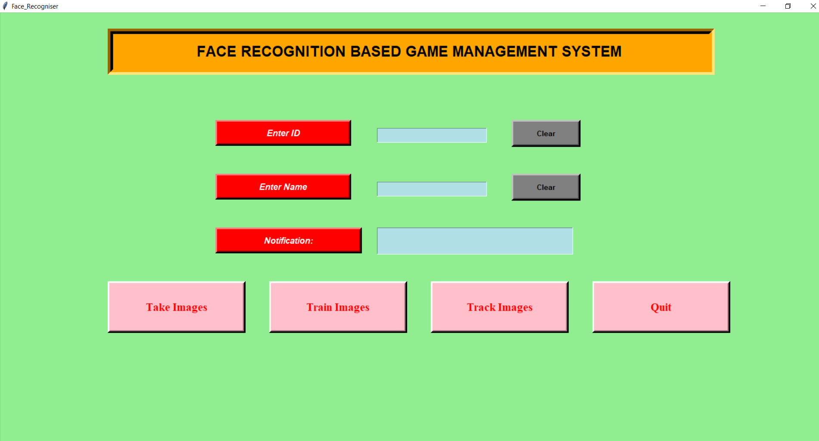
Front View of Project

Slide 14
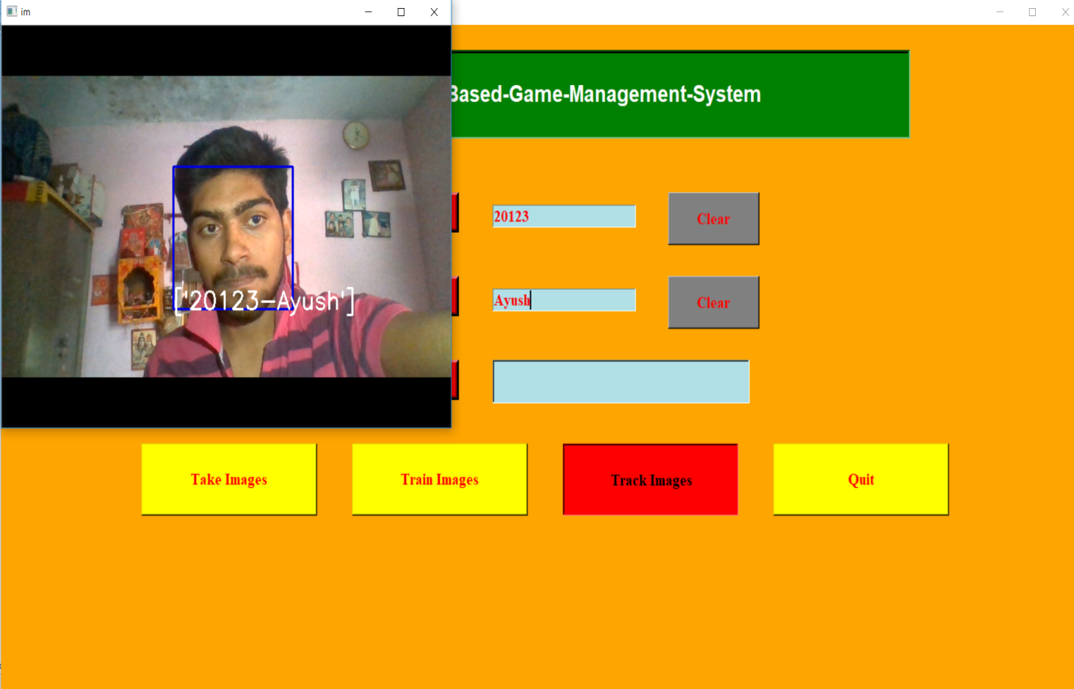
When user Track their Image (if image verified then Game will Opem)

Slide 15
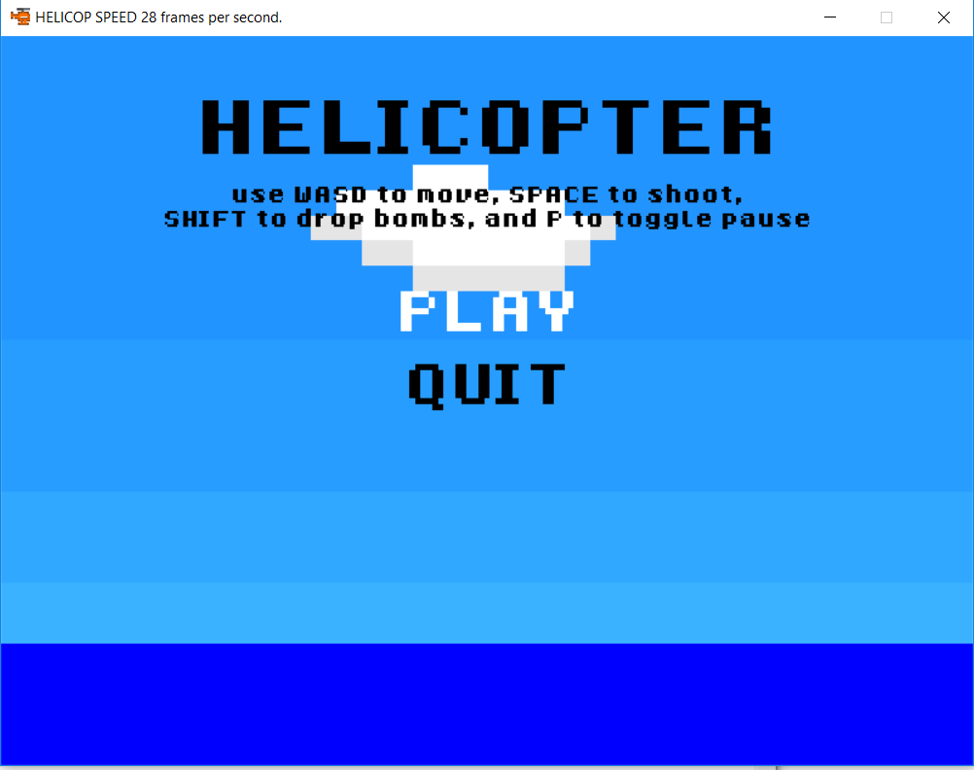
Front View of Game

Slide 16
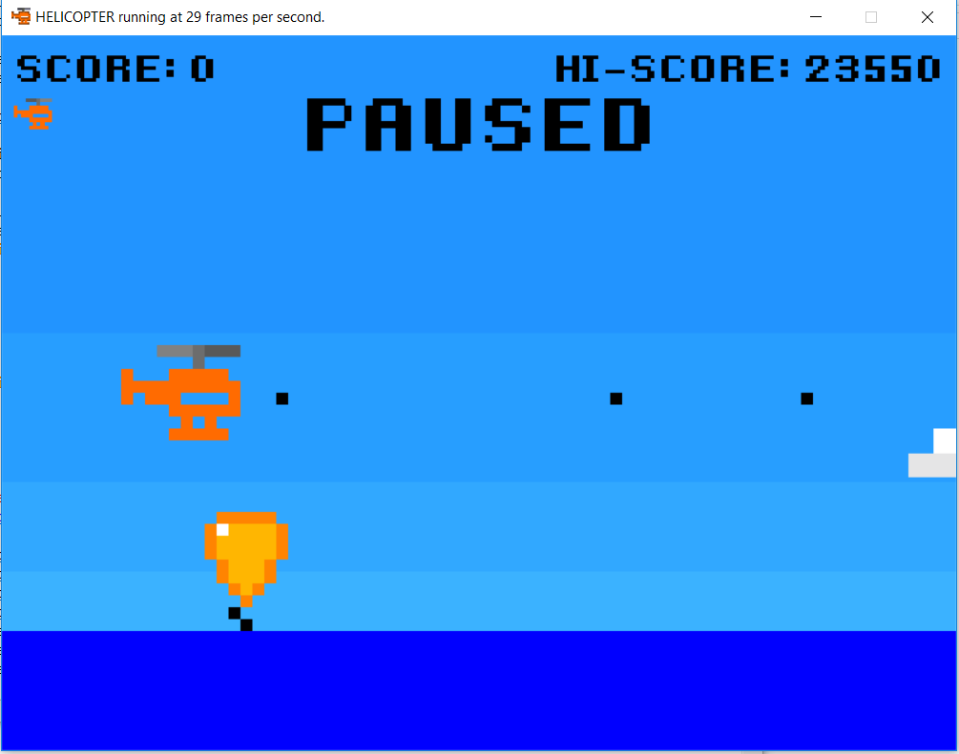
Press P to Paused & Space to Shoot

Slide 17
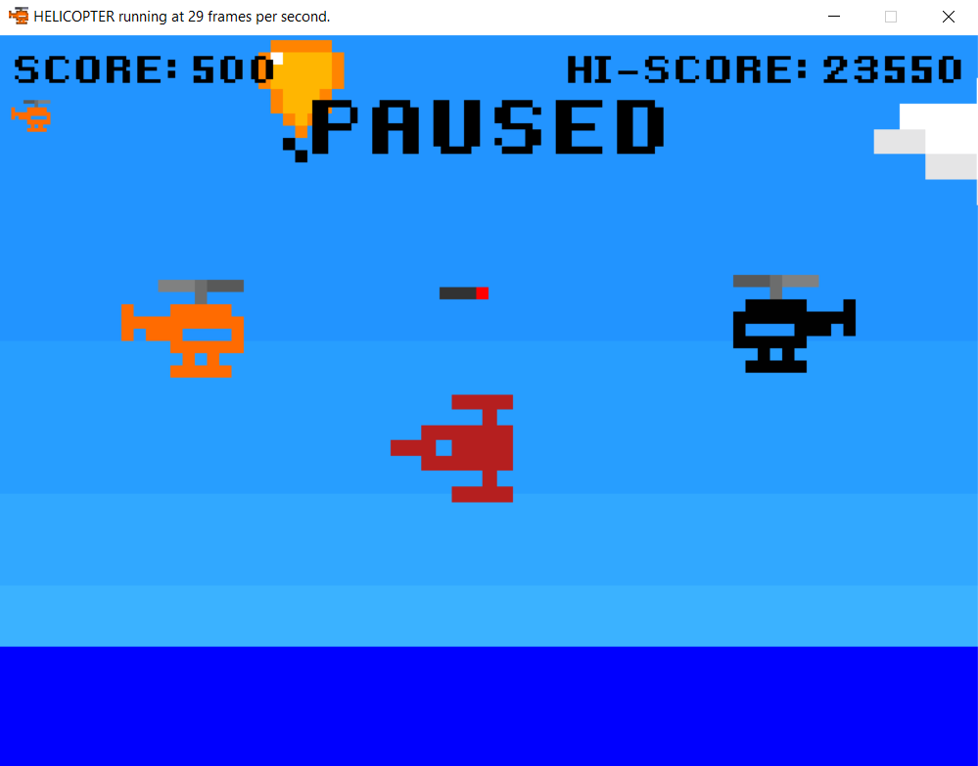
Enemy Heli & Spaceship

Slide 18
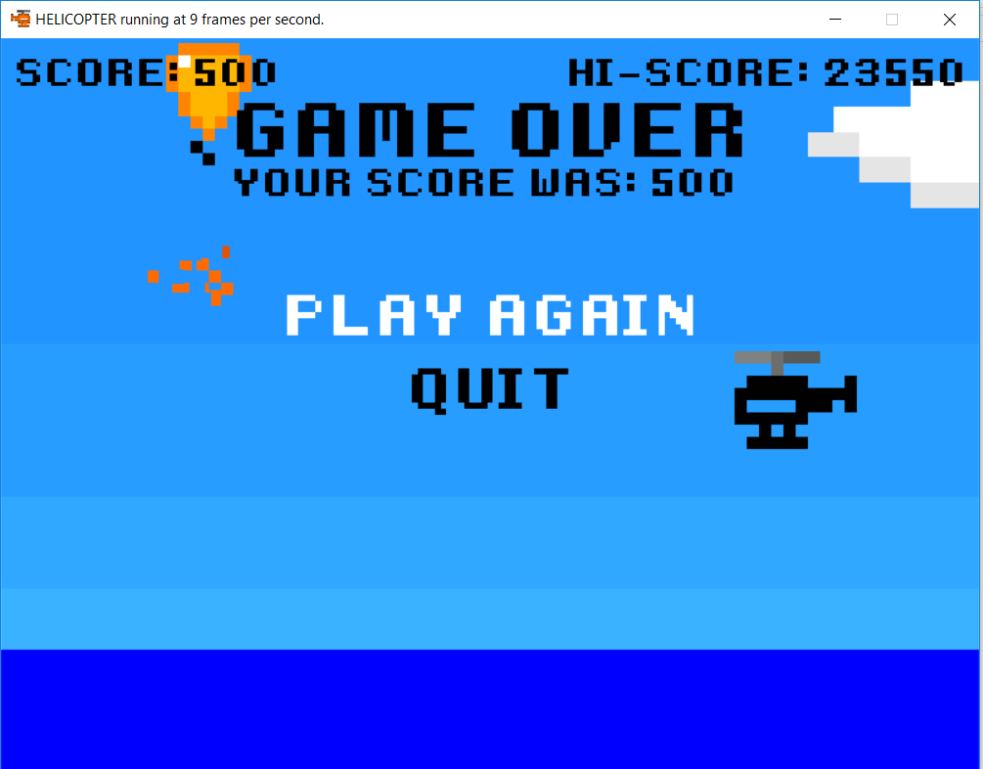
Heli collide with Balloon and the Game over

Slide 19
Advantage of Project
Easy to use & Access
Security on Game
Accurate in Finding Face
Sprites graphic Game
Enjoyable Game
Play with Key Buttons

